Slide 1
Automatic Water Irrigation System

Slide 2
Team short-circuits
Arafat (1415)
ShaidunNahar Shela (1417)
Md. Shah Alam (1409)
Amina Akter Urmi (1454)
Bishwajit Chakraborty (1414)

Slide 3
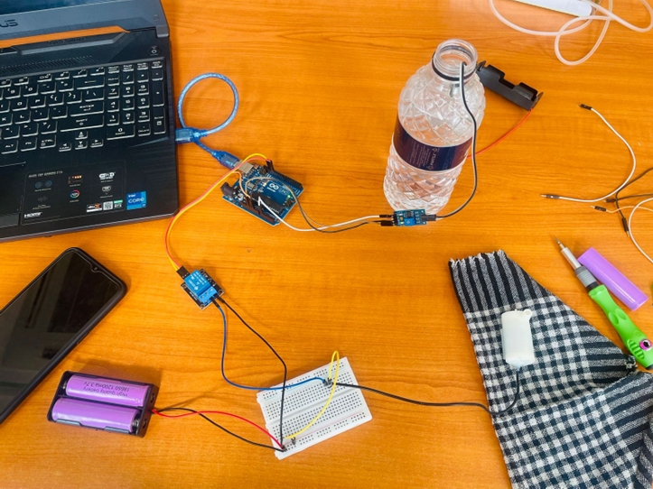
Objective
The primary objective of this project is to create a cost-effective and user-friendly system that can autonomously monitor soil moisture levels and dispense water accordingly, thereby simplifying the task of plant care and maintenance.

Slide 4
Introduction
The Automatic Plant Watering System utilizing Arduino is a project designed to automate the process of watering plants based on soil moisture levels. This system aims to provide an efficient solution for maintaining optimal soil moisture levels, ensuring the health and vitality of plants without the need for manual intervention

Slide 5
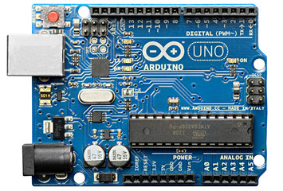
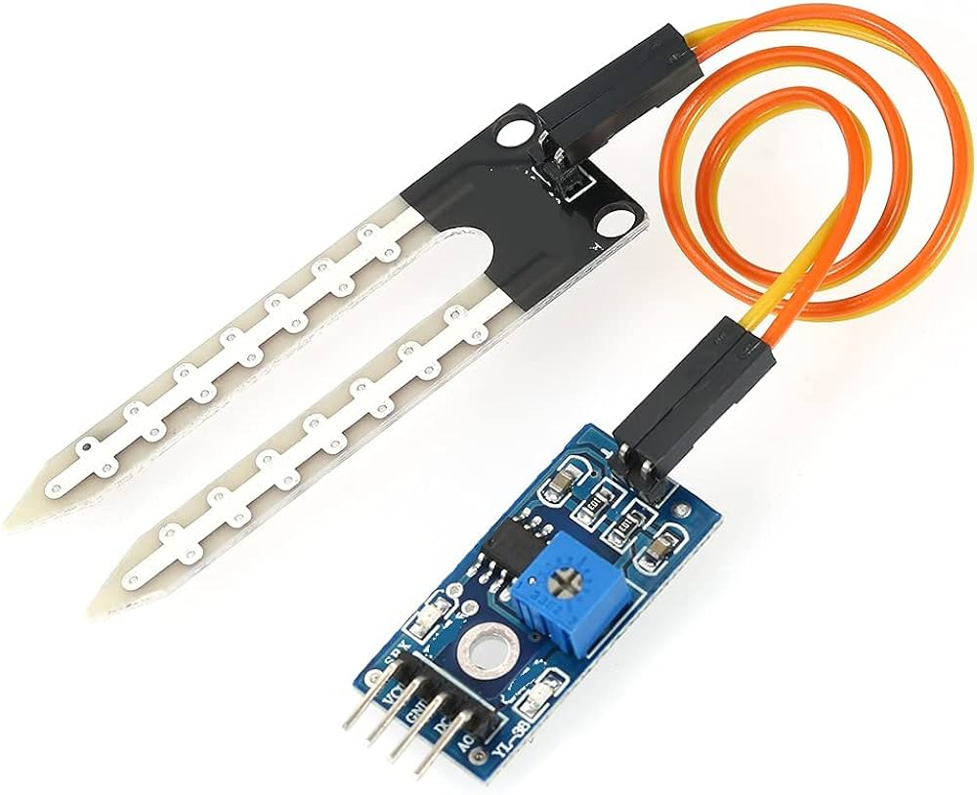
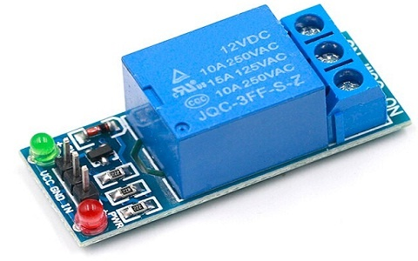
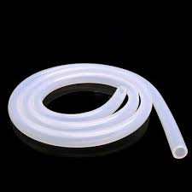
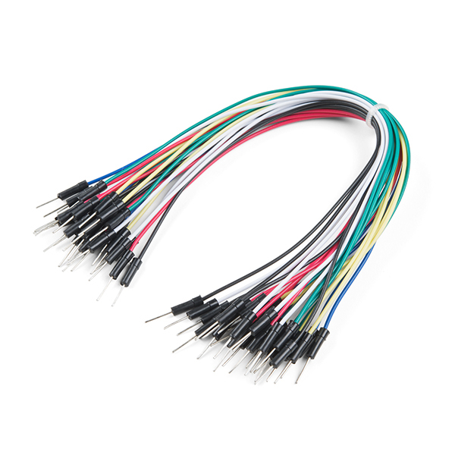
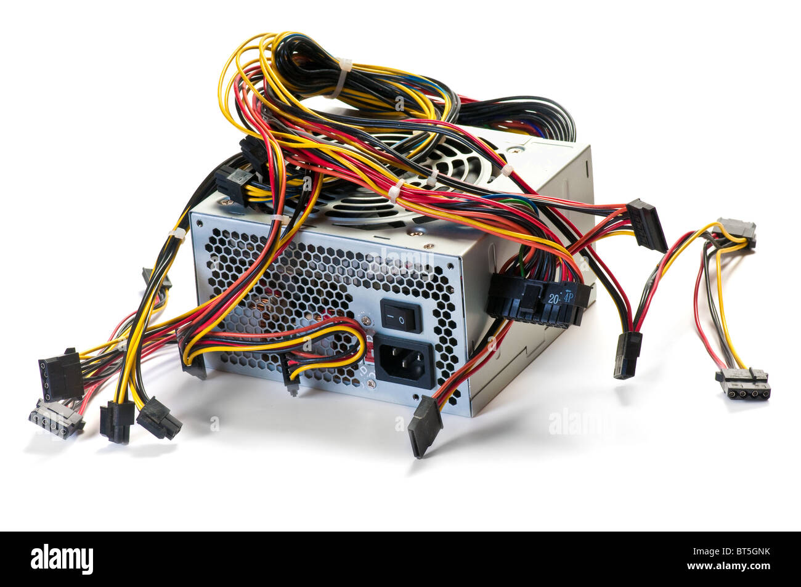
Components
Arduino Uno R3
Soil moisture sensor
Relay module
Peristaltic tubing
Jumper Wires
Power Supply

Slide 6
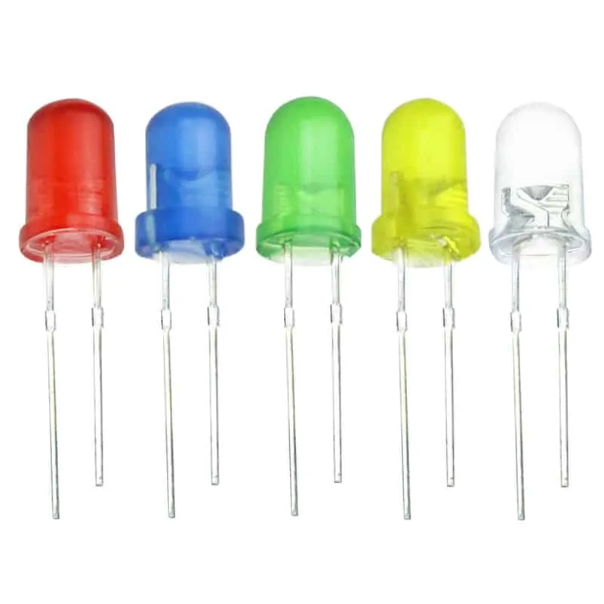
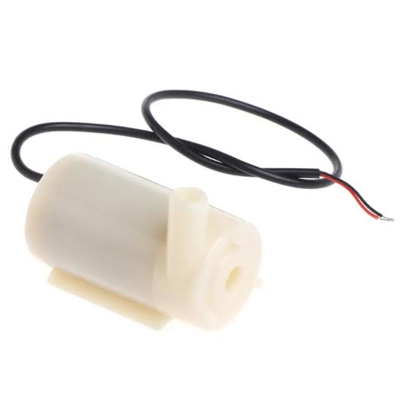
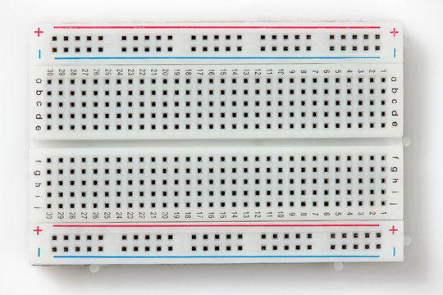
Components
Breadboard
Water pump
LED indicators

Slide 7
Introduce of Components
Arduino Uno R3: The brain of our system, responsible for controlling the entire operation.
Soil Moisture Sensor: Monitors the moisture level of the soil to determine when watering is needed.
Water Pump: Dispenses water to the plant when required, ensuring optimal hydration.
Relay Module: Acts as a switch, allowing the Arduino to control the water pump's operation.
Peristaltic Tubing: Delivers water from the reservoir to the plant's soil with precision and efficiency.
Power Supply: Provides electrical power to the system, keeping it operational.
Water Reservoir: Stores the water to be used for watering the plant.
LED Indicators: Provide visual feedback on the system's status, indicating when watering is in progress or when the reservoir needs refilling.
Jumper Wires: Connect various components together on the breadboard, ensuring seamless communication and power distribution.
Breadboard: Serves as a platform for prototyping and connecting the components securely for testing and development.

Slide 8
Procedure
Circuit Diagram: Create a circuit diagram based on the design you're following. This diagram will guide you in connecting the components correctly.
Connect Power Supply: Connect the power supply to the breadboard. Ensure that the voltage levels are suitable for the components you are using.
Step1: Firstly, Arduino UNO board, relay module, power supply and moisture sensor are setup on the board. These processes are shown in figure;
Step2: And then relay and Arduino UNO board are connected in all pins,
Step3: Moisture sensor is also connected to the UNO board to sense the water content of the plant. This process is shown in figure;
Step4: In this step, the motor is connected to the relay. This is as follows;

Slide 9
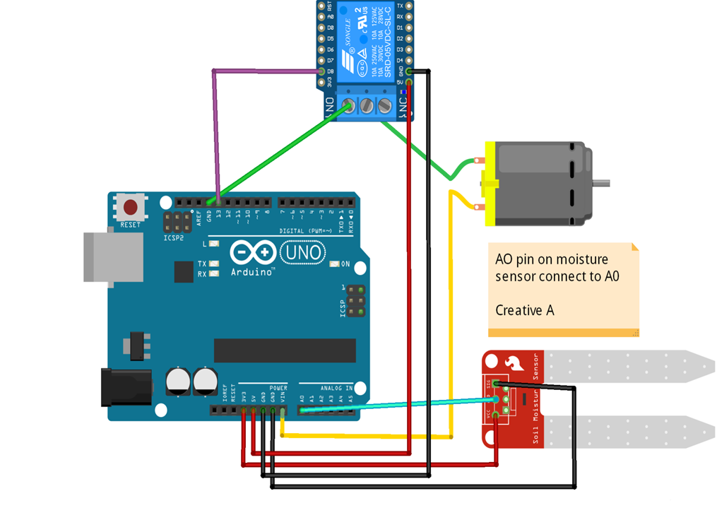
Circuit Diagram

Slide 10
Arduino Logic
if( (soil_moisture>500) && (soil_moisture<1025) ){
Serial.println("dry soil");
digitalWrite(13, LOW);
}

Slide 11
CONCLUSION
The Automatic Plant Watering System using Arduino offers an efficient and reliable solution for automating plant care. By continuously monitoring soil moisture levels and dispensing water as needed, the system promotes healthy plant growth while reducing the burden of manual watering. With further enhancements and refinements, this system has the potential to revolutionize the way plants are cared for in both residential and agricultural settings.

Slide 12
Thank You

